Slide 1






Prof. Mandar Kakade
mnkakade@pict.edu

Slide 2
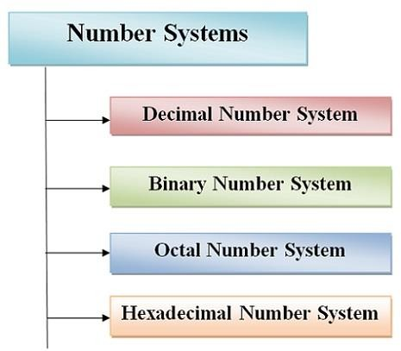

Slide 3
Decimal Number System
𝑁 = ⋯ (𝐷₂ × 𝑅²)+ (𝐷₁ × 𝑅¹)+ (𝐷₀ × 𝑅⁰)+ (𝐷₋₁ × 𝑅⁻¹)+ (𝐷₋₂ × 𝑅⁻²)+ (𝐷₋₃ × 𝑅⁻³)…
Integer Portion Fractional Portion
Where,
N = decimal number with 3-digit integer and 3-digit fractional portion
D = Decimal digits
= 0,1,2,3,4,5,6,7,8,9
R = Radix or base of the number system
For Decimal number system R = 10

Slide 4
Decimal Number System
For Example:
N = (356.238)₁₀
= (3 × 10²)+ (5 × 10¹)+ (6 × 10⁰)+ (2 × 10⁻¹)+ (3 × 10⁻²)+ (8 × 10⁻³)

Slide 6
Binary Number System
𝑁 = ⋯ (𝐵₂ × 𝑅²)+ (𝐵₁ × 𝑅¹)+ (𝐵₀ × 𝑅⁰)+ (𝐵₋₁ × 𝑅⁻¹)+ (𝐵₋₂ × 𝑅⁻²)+ (𝐵₋₃ × 𝑅⁻³)…
Integer Portion Fractional Portion
Where,
N = binary number with 3-digit integer and 3-digit fractional portion
B = Binary digits
= 0,1
R = Radix or base of the number system
For Bibary number system R = 2

Slide 7
Binary Number System
For Example:
N = (110.101)₂
= (1 × 2²)+ (1 × 2¹)+ (0 × 2⁰)+ (1 × 2⁻¹)+ (0 × 2⁻²)+ (1 × 2⁻³)

Slide 8
Octal Number System
𝑁 = ⋯ (𝑂₂ × 𝑅²)+ (𝑂₁ × 𝑅¹)+ (𝑂₀ × 𝑅⁰)+ (𝑂₋₁ × 𝑅⁻¹)+ (𝑂₋₂ × 𝑅⁻²)+ (𝑂₋₃ × 𝑅⁻³)…
Integer Portion Fractional Portion
Where,
N = Octal number with 3-digit integer and 3-digit fractional portion
O = Octal digits
= 0,1,2,3,4,5,6,7
R = Radix or base of the number system
For Octal number system R = 8

Slide 9
Octal Number System
For Example:
N = (152.617)₈
= (1 × 8²)+ (5 × 8¹)+ (2 × 8⁰)+ (6 × 8⁻¹)+ (1 × 8⁻²)+ (7 × 8⁻³)

Slide 10
Hexadecimal Number System
𝑁 = ⋯ (𝐻₂ × 𝑅²)+ (𝐻₁ × 𝑅¹)+ (𝐻₀ × 𝑅⁰)+ (𝐻₋₁ × 𝑅⁻¹)+ (𝐻₋₂ × 𝑅⁻²)+ (𝐻₋₃ × 𝑅⁻³)…
Integer Portion Fractional Portion
Where,
N = Hexadecimal number with 3-digit integer and 3-digit fractional portion
H = Hexadecimal digits
= 0,1,2,3,4,5,6,7,8,9,A,B,C,D,E,F
R = Radix or base of the number system
For Hexadecimal number system R = 16

Slide 11
Hexadecimal Number System
For Example:
N = (F3B.9A2)₁₆
= (𝐹 × 16²)+ (3 × 16¹)+ (𝐵 × 16⁰)+ (9 × 16⁻¹)+ (𝐴 × 16⁻²)+ (2 × 16⁻³)

Slide 12
Conversions
Decimal
Decimal
Decimal
Binary
Binary
Octal
Binary Octal
Hexadecimal Octal Hexadecimal Hexadecimal

Slide 13
1. Decimal to Binary
The most popular way to convert a decimal number into the binary is the double dabble method.
In this method, the given decimal number is progressively divided by 2 and writing the remainder after each division.
When all the remainder is read in reverse order, the binary number is obtained.

Slide 14
1. Decimal to Binary
Steps for Decimal to Binary Conversion
Step – 1 Divide the decimal number which is to be converted by
2 which is the base of the binary number. Step – 2 The remainder which is obtained from step 1 is the least significant bit of the new binary number. Step – 3 Divide the quotient which is obtained from the step 2
and the remainder obtained
of
from this is the second least the binary number.
significant bit
Step – 4 Repeat the process until the quotient remains zero. Step – 5 The last remainder obtained from the division is the most significant bit of the binary number. Hence arrange the number from most significant bit to the least significant bit (i.e., from bottom to top).

Slide 15
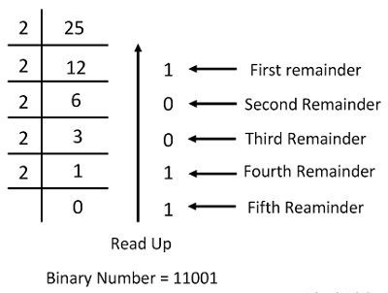
1. Decimal to Binary

Slide 16
1. Decimal to Binary
Conversion of Decimal to Binary for Fraction Number
For fractional decimal numbers, multiply it by 2 and record the carry in the integral position.
The carries when read down produces the equivalent binary fraction as explained by the example given below.

Slide 17
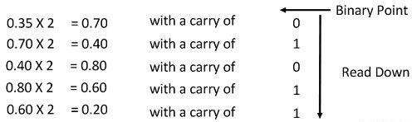
1. Decimal to Binary
Consider the fractional decimal number 0.35
The process of multiplication by 2 will continue till the desired accuracy is achieved.

Slide 18
2. Binary to Decimal
The binary number system consists only two digits 1 and 0.
The base of the binary number system is 2, and it is increased by the factor of two.
The first digit has 2⁰ weights, the second has
₂1
weights, the weight of the third digit is
2² and so on.
In the binary number system each digit position has a weight regarding powers of two.

Slide 19
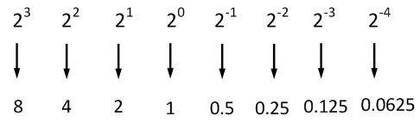
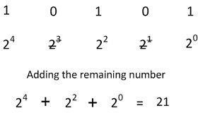
2. Binary to Decimal
The conversion of the binary number (10101)₂ into its equivalent
decimal number

Slide 20
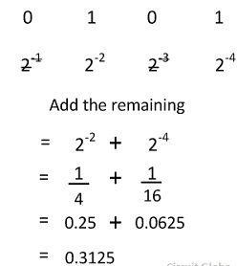
2. Binary to Decimal
The conversion of a fractional binary
(0.0101)₂ into its equivalent decimal number
number

Slide 21
3. Decimal to Octal
Steps for Decimal to Octal Conversion
Step – 1 Divide the decimal number which is to be converted by
8 which is the base of the octal number. Step – 2 The remainder which is obtained from step 1 is the least significant bit of the new octal number. Step – 3 Divide the quotient which is obtained from the step 2
and the remainder significant bit
obtained
of
from this is the second least the octal number.
Step – 4 Repeat the process until the quotient remains zero. Step – 5 The last remainder obtained from the division is the most significant bit of the octal number. Hence arrange the number from most significant bit to the least significant bit (i.e., from bottom to top).

Slide 22
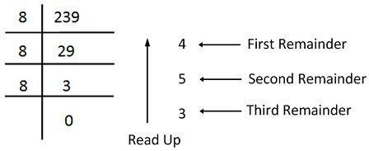
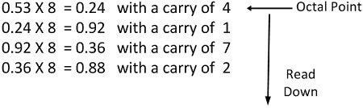
3. Decimal to Octal
Consider the conversion of the decimal number (239.53)₁₀ . The conversion of integer part is shown below.
And the fraction part
(239.53)_{𝟏𝟎} = (354.4172)_{𝟖}

Slide 23
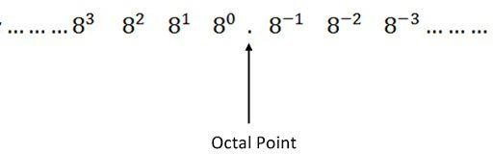

4. Octal to Decimal
In octal number system, each digit position has the weight eight regarding power eight shown in the figure below.
Consider the octal number (354.42)₈ into its equivalent decimal number. The integer part 354 converts to octal shown below.
And the fractional parts 0.42 converts to octal
(354.42)₈ = (236.53125)₁₀

Slide 24
5. Decimal to Hexadecimal
Steps for Decimal to Hexadecimal Conversion
Step – 1 Divide the decimal number which is to be converted by
16 which is the base of the hexadecimal number. Step – 2 The remainder which is obtained from step 1 is the least significant bit of the new hexadecimal number. Step – 3 Divide the quotient which is obtained from the step 2 and the remainder obtained from this is the second least significant bit of the hexadecimal number. Step – 4 Repeat the process until the quotient remains zero. Step – 5 The last remainder obtained from the division is the most significant bit of the hexadecimal number. Hence arrange the number from most significant bit to the least significant bit (i.e., from bottom to top).

Slide 25
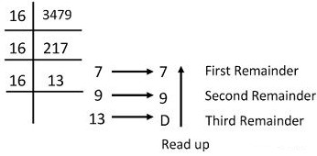
5. Decimal to Hexadecimal
Consider the conversion of the decimal number (3749)₁₀ into its hexadecimal equivalent number.
(3749)_{𝟏𝟎} = (D97)_{𝟏𝟔}

Slide 26
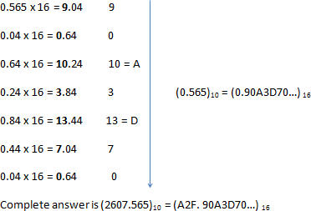
5. Decimal to Hexadecimal
For fractional decimal numbers, multiply it by 16 and record the carry in the integral position.
The carries when read down produces the equivalent binary fraction as explained by the example given below.

Slide 27
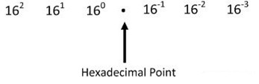
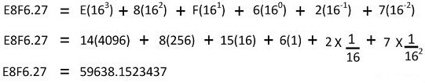
6. Hexadecimal to Decimal
The base of the hexadecimal number system is 16, therefore the weights corresponding to various positions of the digits will be as shown below.
For instance, consider the conversion of hexadecimal number
(E8F6.27)₁₆ into its equivalent binary number.
(E8F6.27)_{𝟏𝟔} = (59638.1523437)_{𝟏𝟎}

Slide 28
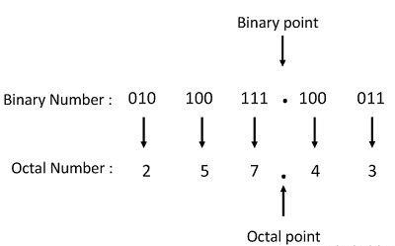
7. Binary to Octal
The conversion of binary to octal is a reversal of the above procedure. For example, the binary number (010100111.100011) can be converted into an octal number by first written the bits in the group of three and then awarding the decimal number of to each of the group of three bits as shown below.
(010100111.100011)
= (257.43)
𝟖
𝟐

Slide 29
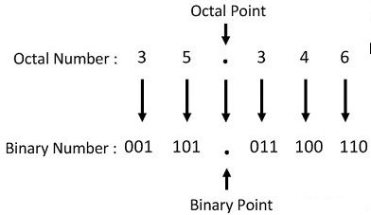
8. Octal to Binary
The base of the octal number system (8) is the third power of base of a binary system (2), the interconversion of octal and a binary number is very simple and direct as explained below.
Let converting the octal number 35.346 to its equivalent binary number
(35.346) = (001101.011100110)
𝟐
𝟖

Slide 30
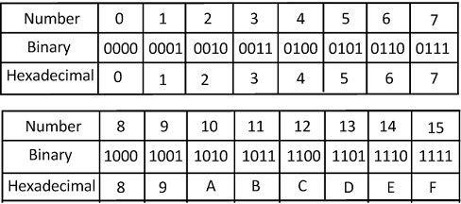
9. Binary to Hexadecimal
The base of the binary number system is two because it is represented by two digits, i.e., 0 and 1. It is difficult to represent the large number in the form of binary digit and hence the hexadecimal system are used in the digital electronics. The hexadecimal number systems are easily converted into a binary system by using the method explains below.
(101101001101.100^{Dr.}1^{So}1^{oje}1^{y} 1De1^{shp})ª₂nd=^{e 878}(⁸D⁵⁵⁷4³⁹B⁰ .9F)₁₆

Slide 31
10. Hexadecimal to Binary
For converting any hexadecimal number to binary, the binary representation as detailed above in Table is to be written for each hexadecimal digit.
(2C6B.E2)₁₆ = (0010 1100 0110 1011. 1110 0010)₂

Slide 32
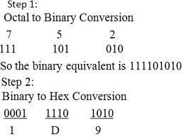
11. Octal to Hexadecimal
First convert an octal number to a number, then convert it to a ​hexadecimal.
binary
(752)₈ = (1 D 9)₁₆

Slide 33
12. Hexadecimal to Octal
In this method, each digits of the hexadecimal number is replaced by its 4 bits equivalent, first we find the binary equivalent of the digit. If, it is not in 3 bits ,then the zeroes are placed before the binary equivalent to make it 4 bits
Convert (524.36)16 into its binary equivalent
First of all, convert each of the digits into its binary bits and then group the subsequent bits into 4 bits .If, they all are not able form the group of 4 then, zeroe’s (0) are left padded to form the 4 bit pair.
5 2
0101 0010
4 .
0100
3 6
0011 0110 ( 4 bits
representation ) (524.36)16 =
(0101 0010 0100 . 0011 0110)2

Slide 34
12. Hexadecimal to Octal
Then convert the binary number (11011.1011) to its octal equivalent
This conversion is simple. In this case ,first the binary bits are grouped into 3 bits .If ,they are not forming then zeros are left padded.
After that each groups are converted into its octal equivalent using the table:
11011.1011
011 011 . 101 100
3 3 5 4
= (33.54)8
(11011.1011)16

Slide 35
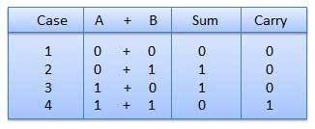
Binary Addition
There are four points or steps to remember before proceeding through the operation.
These are

Slide 36
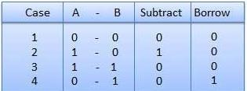
Binary Subtraction
Subtraction and Borrow, these two words will be used very frequently for the binary subtraction. There are four rules of binary subtraction.

Slide 38
Binary Subtraction by 1’s
Complement Method
What is 1’s compliment of a Binary number?
Replace all 1 to 0 and 0 to 1
For example
Original Binary Number
1’s Compliment of Original Binary Number
The steps to be followed in subtraction by 1’s complement are:
Write down 1’s complement of the subtrahend.
Add this with the minuend.
If the result of addition has a carry over then it is dropped and an 1 is added in the last bit.
If there is no carry over, then 1’s complement of the result of addition is
obtained to get the final result and it is negative.
1 | 1 | 0 | 0 | 1
0 | 0 | 1 | 1 | 0

Slide 39
Binary Subtraction by 1’s
Complement Method
For Example
1011.001 – 110.10
1’s complement of 110.10 is 1001.011 Hence
Minuend -
1’s complement of subtrahend -
Carry over -
1 0 1 1 . 0 0 1
1 0 0 1 . 0 1 1
1 0 1 0 0 . 1 0 0
1 0 1 0 0 . 1 0 1
The required difference is 1 0 0 . 1 0 1
When Carry over generates, result is +ve and obtained by adding carry over in the result.

Slide 40
Binary Subtraction by 1’s
Complement Method
10110.01 – 11010.10
1’s complement of 11010.10 is 00101.01 Hence
Minuend - |  | 1 0 1 1 0 . 0 1
1’s complement of subtrahend - |  | 0 0 1 0 1 . 0 1
Carry over - | 0 | 1 1 0 1 1 . 1 0
1’s complement of result 0 0 1 0 0 . 0 1
The required difference is 1 0 0 . 0 1
When Carry over do not generates, result is -ve and
obtained by taking 1’s compliment of the result

Slide 41
Binary Subtraction by 2’s
Complement Method
What is 2’s compliment of a Binary number?
Get 1’s compliment of subtrahend
Add 1 to LSB
For example
Original Binary Number
1’s Compliment of Original Binary Number Add 1 to LSB of 1’s Compliment
2’s Compliment of subtrahend
1 | 1 | 0 | 0 | 1
0 | 0 | 1 | 1 | 0
 |  |  |  | 1
0 | 0 | 1 | 1 | 1

Slide 42
Binary Subtraction by 2’s
Complement Method
The operation is carried out by means of the following steps:
At first, 2’s complement of the subtrahend is found.
Then it is added to the minuend.
If the final carry over of the sum is 1, it is dropped and the result is positive.
If there is no carry over, the two’s complement of the sum
will be the result and it is negative.

Slide 43
Binary Subtraction by 2’s
Complement Method
1010.11 – 1001.01
2’s complement of 1001.01 is 0110.11. Hence
Minuend - 1 0 1 0 . 1 1
2’s complement of subtrahend -
Carry over 1
0 1 1 0 . 1 1
0 0 0 1 . 1 0
The required difference is 0001.10
If carry over generates, then result is +ve and it is as it is

Slide 44
Binary Subtraction by 2’s
Complement Method
10100.01 – 11011.10
2’s complement of 11011.10 is 00100.10. Hence
Minuend - 1 0 1 0 0 . 0 1
2’s complement of subtrahend - 0 1 1 0 0 . 1 0
Result of addition - 1 1 0 0 0 . 1 1
As there is no carry over the result of subtraction is negative and
is obtained by writing the 2’s complement of 11000.11.
Hence the required result is – 00111.01.
If carry over do not generates, then result is -ve and it is in 2’s compliment form.

Slide 45
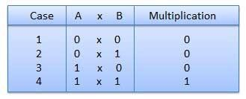
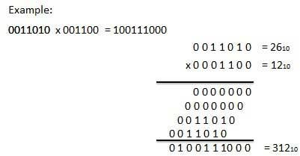
Binary Multiplication
Binary multiplication is similar to decimal multiplication. It is simpler than decimal multiplication because only 0s and 1s are involved. There are four rules of binary multiplication.

Slide 46
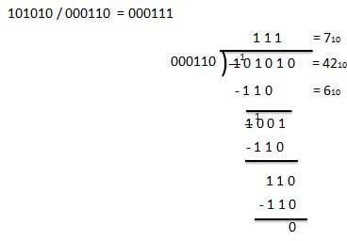
Binary Division
Binary division is similar to decimal division. It is called as the long division procedure.

Slide 47
Questions on G3.1
Convert
(10101.1101)₂ to Decimal
(432.14)₁₀ to Hexadecimal
(462.27)₈ to Hexadecimal (2BA.0C)₁₆ to Octal (B89A.03)₁₆ to Decimal
Perform the following arithmetic operations (110011 – 011011) using 2s compliment method
(1101 X 110)
(110011 /101)
(111011.11 + 100100.01)
(110011-111001) using 2s compliment method

